Slide 1



GETTING INTO HUGGINGFACE

Slide 2
WHAT IS ?
Hugging Face is an open source ML & DS community platform. It provides various tools to build, train and deploy ML model. On Hugging Face, ML Engineers and Data Scientist get support and contribute to the open source of machine learning.

Slide 3

Github of Machine Learning
Easy Interface, Easy Deployment
WHY TO USE
Community Approach for rapid growth in AI
State of Art Models
Widespread Support

Slide 4

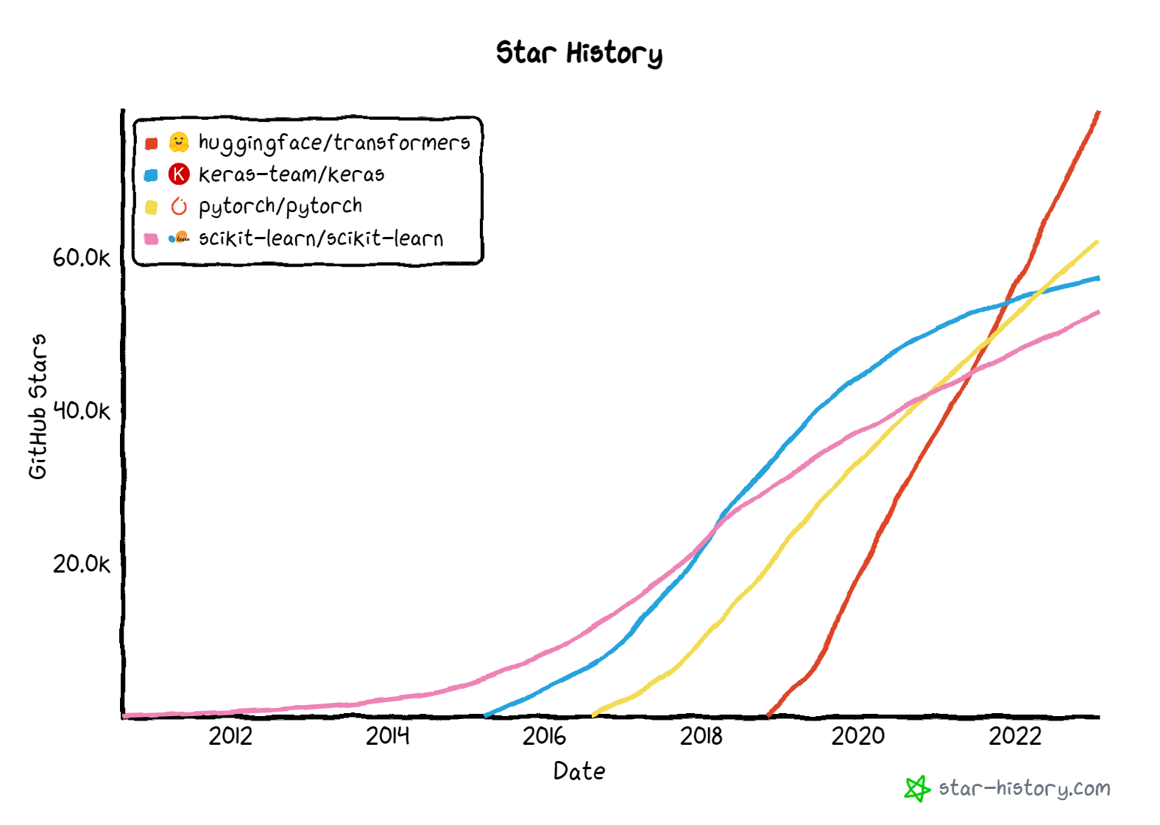

Slide 5
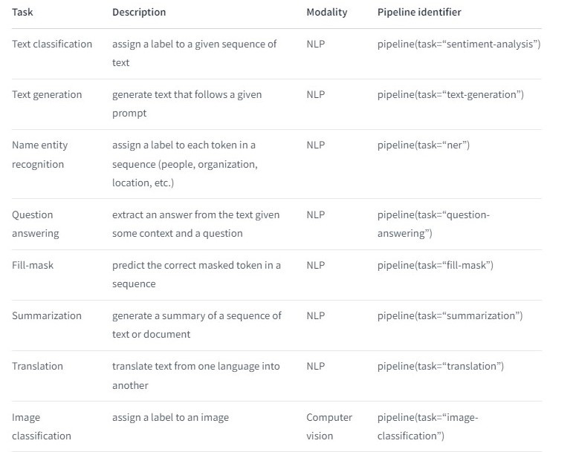

Slide 6
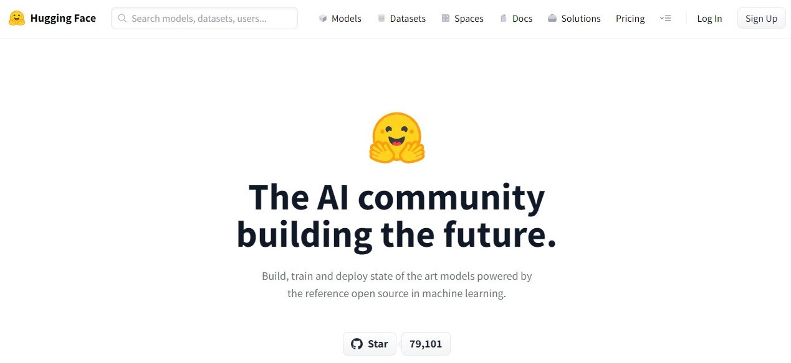
https://huggingface.co/

Slide 7
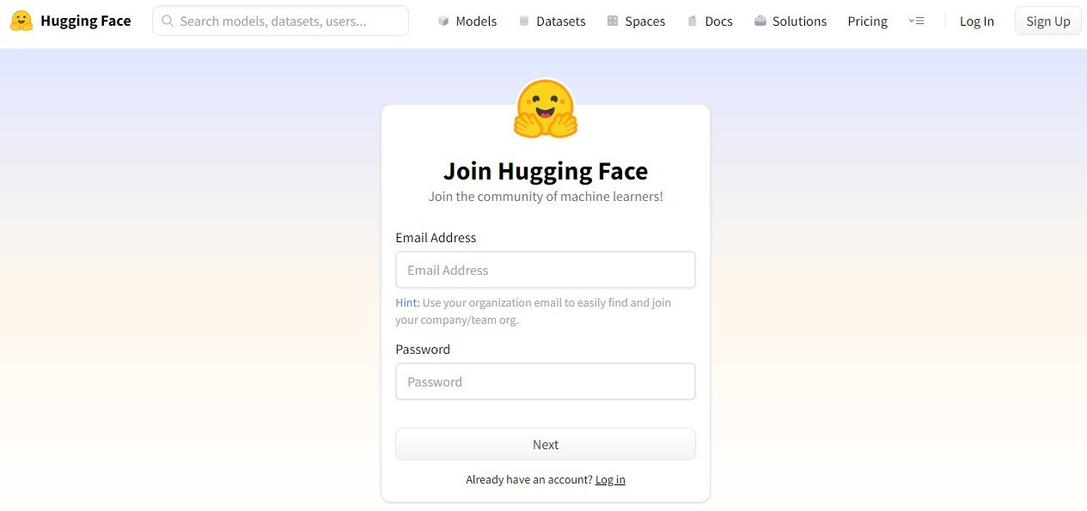
https://huggingface.co/join

Slide 8
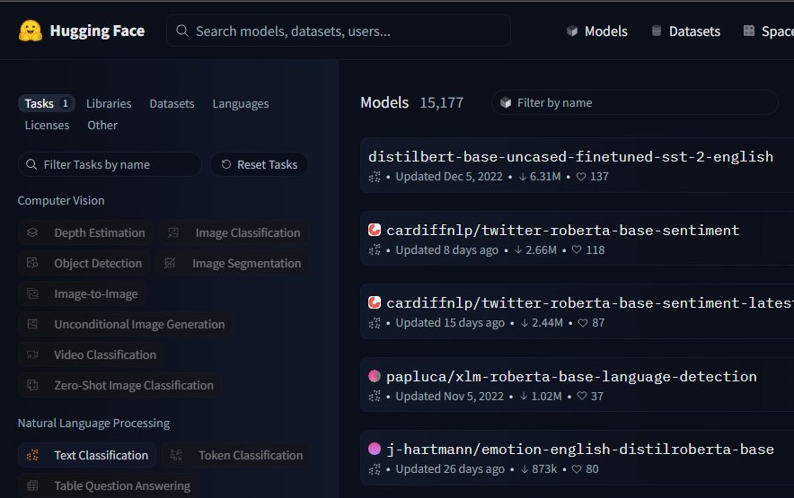
LET'S EXPLORE

Slide 9

LET'S BUILD USING HUGGINGFACE

